Slide 1
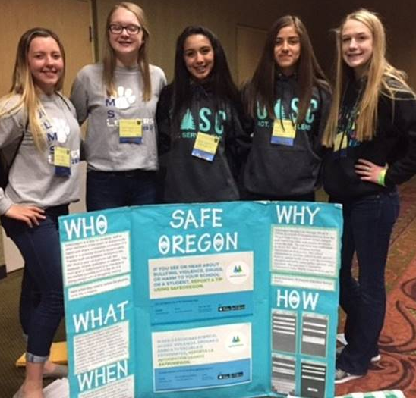
Statewide School Safety Tip Line
Webinar
Notes:
Introduction of the name SafeOregon – Oregon’s Statewide School Safety Tip Line.

Slide 2
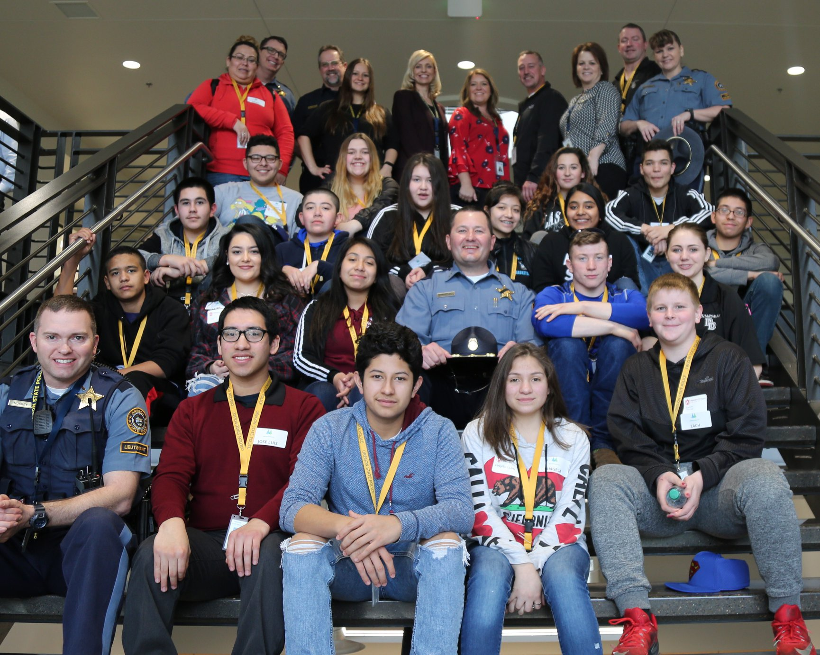

Slide 3
Co-Chairs Clackamas County Sheriff Craig Roberts and Dr. David Novotney Willamette Education Service District.
Task Force charged with improving safety and security at schools across the state.
OTFSS information and meeting minutes can be found at http://www.oregon.gov/osp/Pages/Task-Force-on-School-Safety.aspx.
Notes:
School Safety Task Force created by the 2014 Legislature.
Representatives from law enforcement, fire, schools, and organizations that support those collective efforts, for example; Chiefs of Police Association, Oregon School Boards Association.

Slide 4
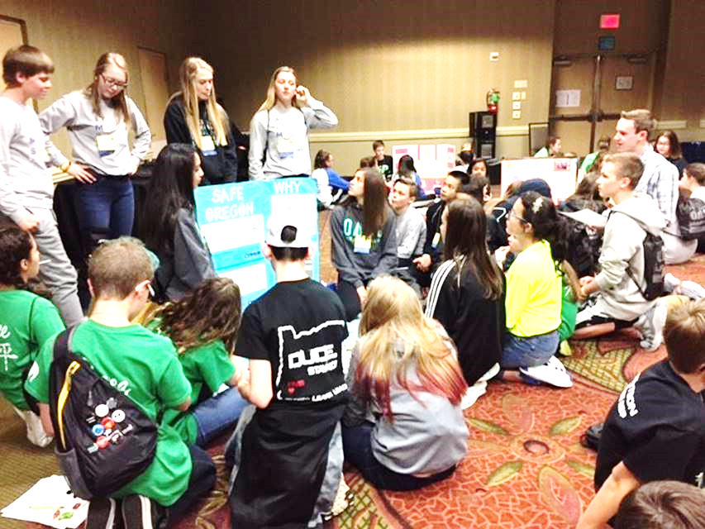
Oregon Task Force on School Safety
2015 OTFSS Report to the Oregon State Legislature
Recommendations:
Statewide threat assessment system
Statewide school floor plan database
Standardized terminology
Statewide safety tip line (HB 4075 2016)
Notes:
4 recommendations. Focusing on one of those today – Statewide School Safety Tip Line.
Task force took a look at Oregon’s former tip line – existed in 2009, but was dropped due to funding – They considered several presentations from successful regional and national tip lines, which led the task force to strongly recommend the reinstatement of a statewide anonymous tip line.
In the coming months you’ll hear more about the Statewide Threat Assessment System with new legislation introduced this year. SB414 from Senator Johnson. Establishes regional support for Threat Assessment with 15 staff through the Department of Education, focused on supporting local efforts.

Slide 5
Goal: School Safety Tip Line
Allow students, and other members of the public to use voice, text, phone, photos and videos to confidentially or anonymously transmit messages and information regarding potential harmful or criminal acts against students, school employees, or school property.
Focus started with public schools PK-12
570,857 students
19 Education Services Districts
211 School Districts
1,200+ schools
Open to private schools PK-12 now.
Notes:
Task force goal to provide resources that could be used readily by any school. Focusing on Public Schools PK-12 to start, recently opened up to private schools for the same grade levels.
Oregon State Police is providing this tool – through a vendor provided solution - setting it up to be available statewide.
Focusing on public schools, we’ll be ready to help private schools too and will look to community colleges and others after we get most of the public schools on board.
There are some schools that have a tip line today, all will be motivated to move over to the statewide system.

Slide 6
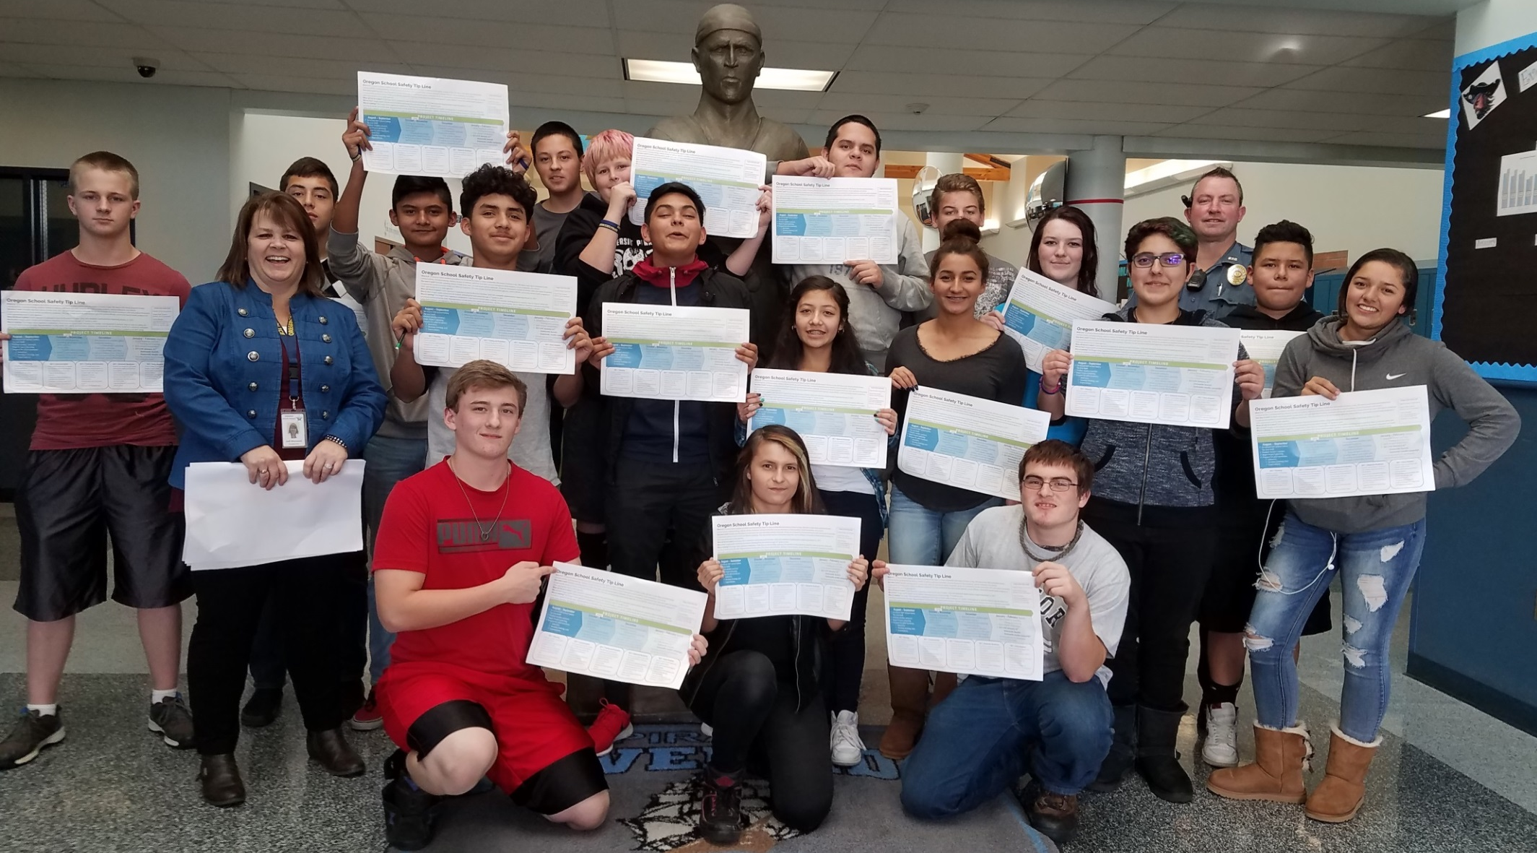
Partnerships: Riverside Jr./Sr. High School

Slide 7
Submit Information: 5 ways to confidentially or anonymously report tips
Notes:
Tip line can be accessed through several means.
E-mail
Call
Text
Mobile application
Web Portal
Through out vendor, we provide staff available 24 x 7 x 365 days a year to receive the tips. They assess the severity of the information, they work to draw out more information and they share that information in the back end database.

Slide 8
24 x 7 x 365
Tip Line Technicians
Operation Manual
Central database
Share everything with schools or law enforcement
Notes:
The information comes in to a central database, triaged by technicians who are trained in recognizing mental health crisis, have expected work flows and an operation manual that we will continue to review and update.
They’ll send that information to the schools or directly to law enforcement depending on the situation.

Slide 9
Tip Line Technicians:
Experience or training in call taking, crisis management, recognizing mental illness and emotional disturbance.
Training in privacy, FERPA, HIPAA, state specific statutes, telephone operations and social media monitoring, etc.
Licensed social workers and counselors in addition to skilled non-licensed/non-clinical health service representatives. Licensed staff provide oversight, training and handle escalated calls.
Provide other services across Oregon: Intake and dispatch for Lane county Community Health Services, Oregon Department of Human Services (District 2), with their nurse triage partner they deliver medical advice and call intake services for clients such as CareOregon, Oregon's Health Co-Op, Multnomah County Health Centers, and Southern Oregon Pediatrics.
Notes:
The information comes in to a central database, triaged by technicians who are trained in recognizing mental health crisis, have expected work flows and an operation manual that we will continue to review and update.
They’ll send that information to the schools or directly to law enforcement depending on the situation.

Slide 10
Tip Levels: When local dispatch is notified.
Tips are triaged and assessed for level of severity, timeliness, and assistance needed. CRITICAL immediate or imminent threat of violence, potential self-harm, potential harm or criminal acts. 2 minute notification. URGENT ongoing or past incidents of violence, self-harm, or criminal acts. High potential for occurring again. 10 minute notification.
STANDARD peer to peer interactions that schools typically deal with (student arguments, school rule violations). 1 hour notification.
OTHER Tips that don’t meet the criteria above.
85%
5%
Notes:
We do expect students to still use 9-1-1 for in process activity. But, if something is received through the tip line, we will do that notification either by keeping the student on the line and connecting them straight to 9-1-1 or making that call if they disconnect.
Remember, a student may not recognize the activity as a 9-1-1 call. In most every case where there was a school shooting or violent activity, someone knew something. A student may be offering information about a best friend, an activity they were not clear what they saw, or something that made them uncomfortable – or simply that they themselves need help. A school safety tip line is there to help with that gap.
If technicians assess something in the critical or urgent category – the are calling the local 9-1-1 dispatch, simultaneously their co-worker is calling the contact at the school identified in the school sign-up process.
If asked: The local 9-1-1 information is also gained at the school sign-up process.

Slide 11
School Role and Responsibility
Schools must sign up for students to use the system in your school.
Schools designate a primary contact to work with SafeOregon, with secondary back-ups in case the primary is unavailable; all receive access to a dashboard.
More options available.
Follow-up on tips and information received.
Champion SafeOregon in your school.

Slide 12
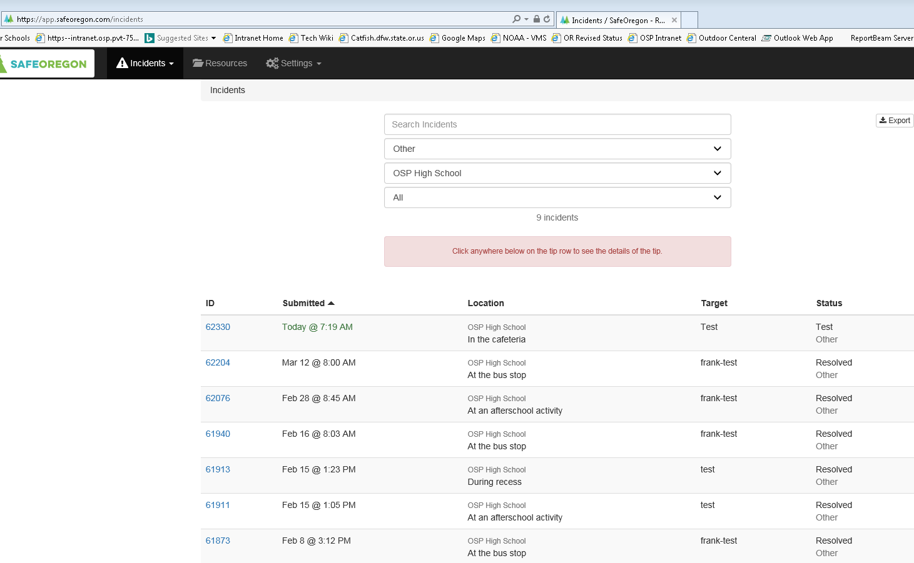
Web Based Dashboard
Back-end process
Record of all tips
Track follow-up on tips
Charts/data
Toolkits
Marketing
How to launch to your school
Training
Best practice on response to tips
System follow-up is a click of a box or typed in if it’s important to do so.

Slide 13
School Sign-up Triggers Marketing Packet in the Mail
SPANISH
Posters and Student Cards
VIETNAMESE
RUSSIAN

Slide 15
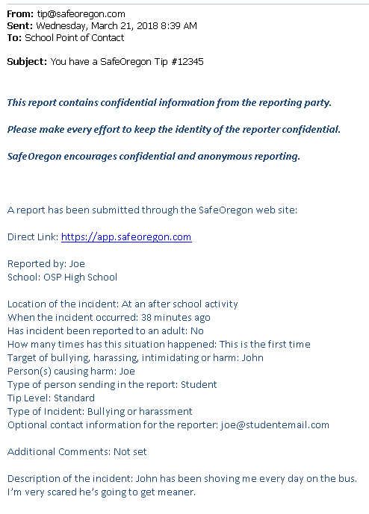

Slide 16
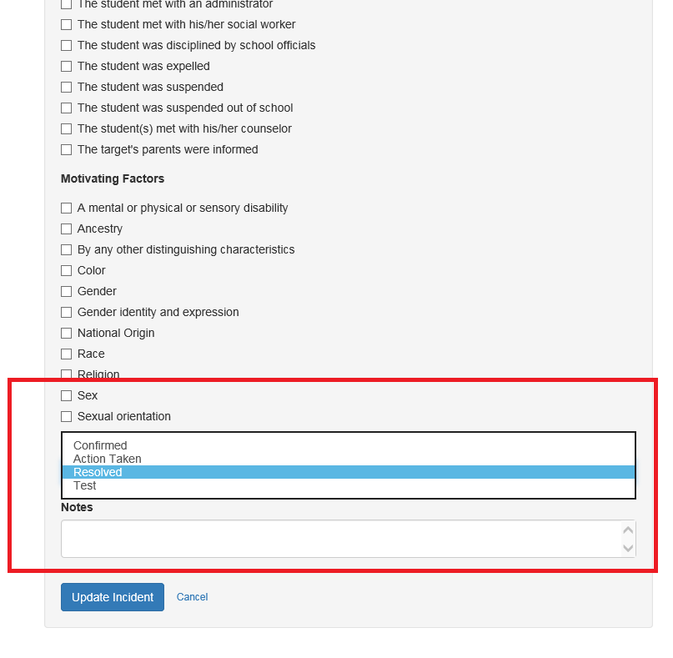
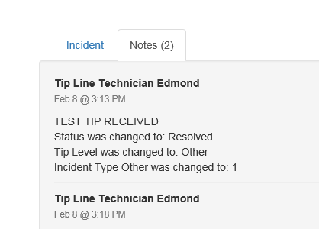

Slide 17
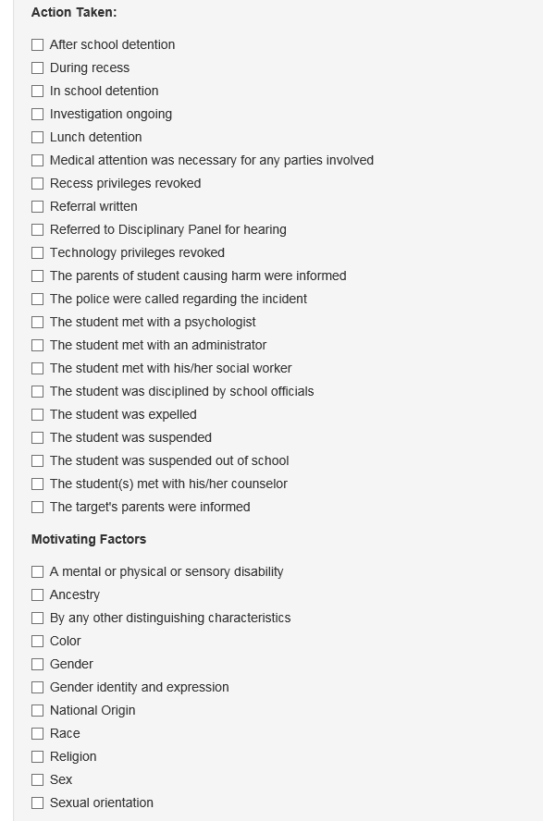

Slide 18
Received over 1000 tips overall:
Majority reports from students about other students with concerns of safety:
Bullying/Harassment
Threat to Safety
Drugs
Suicide Threat- reported by another
Students may report more than once, with different report methods
Parents and community members submit tips

Slide 19
Real Tip (specifics removed)
“She was talking to me in the hallway and i notice that she has cuts on her wrist and I have seen it before, she says she's depressed and she says she sad all the time”
Named Student
Anonymous Tip

Slide 20
Real Tip (specifics removed)
Two named students.
“They are fighting and I don't know what to do because they are both my friend and I don't want them to hate me because I don't wanna choose sides and I don't want them to get mad because I'm trying to fix things but idk.”
Named Reporter

Slide 21
Real Tip (specifics removed)
“Melissa was crying after class because a group of boys were saying things like "I'm gonna rape you" and doing motions behind her that were inappropriate. She says that she felt very uncomfortable but was afraid to tell anyone. I am unsure of whether or not they will actually do anything but that doesn't mean they should still be able to tell her those things and make her feel uncomfortable or worried. Melissa has also mentioned that they might have been going behind her and doing inappropriate motions for a couple of weeks, she just didn't realize what they were doing until recently.”

Slide 22
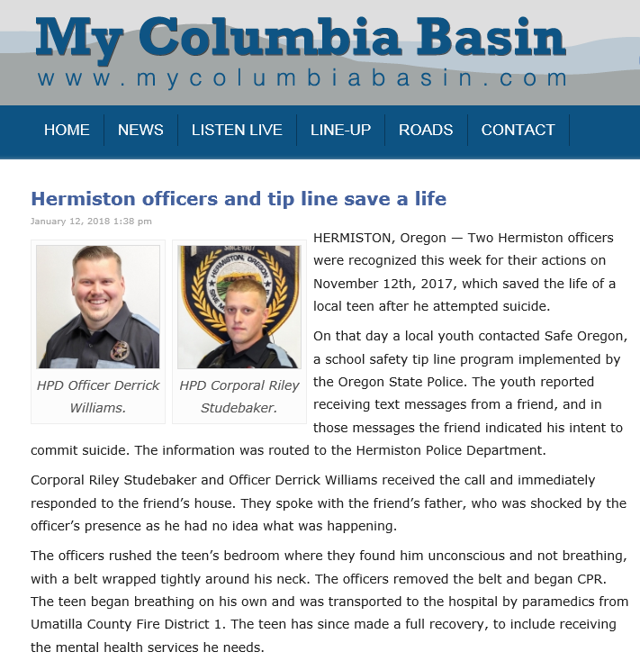

Slide 23
Follow-up and handling tips
Short Term Actions
Long Term Results
Fidelity
Reliable
Trust
Committed to effort

Slide 24
School Example: Adding conversation to health curriculum
EXAMPLE
Notes:
This is an example of one school integrating it into the school curriculum. It’s part of a health class. They not only talk about what SafeOregon is but the responsibility as a fellow student to use it.

Slide 25
School Example: Notification to Parents
EXAMPLE

Slide 26
From a Principal of one School using SafeOregon today
“In the two weeks […] since our launch of SafeOregon we received 20 reports, 18 have been legitimate including bullying […], suicidal feelings, sexual harassment, and drug use. Action taken has ranged from consultation with law enforcement, suspensions, or counseling the student or group of students.
In one particular instance, a student reported a girl posting suicidal thoughts on social media. SafeOregon called school administration, and the police were involved. The girl was taken to the hospital for evaluation, potentially saving her life. Another student reported her friend was being bullied. […] The victim came up to me later, gave me a hug and thanked me for protecting and supporting him.
During lunch, students can be heard casually talking about SafeOregon. […] Students don’t always have the maturity or support to navigate a situation alone. SafeOregon has provided our students the opportunity to feel safe so they can be ready to learn at high levels and be a contributing member of our school community.”

Slide 27
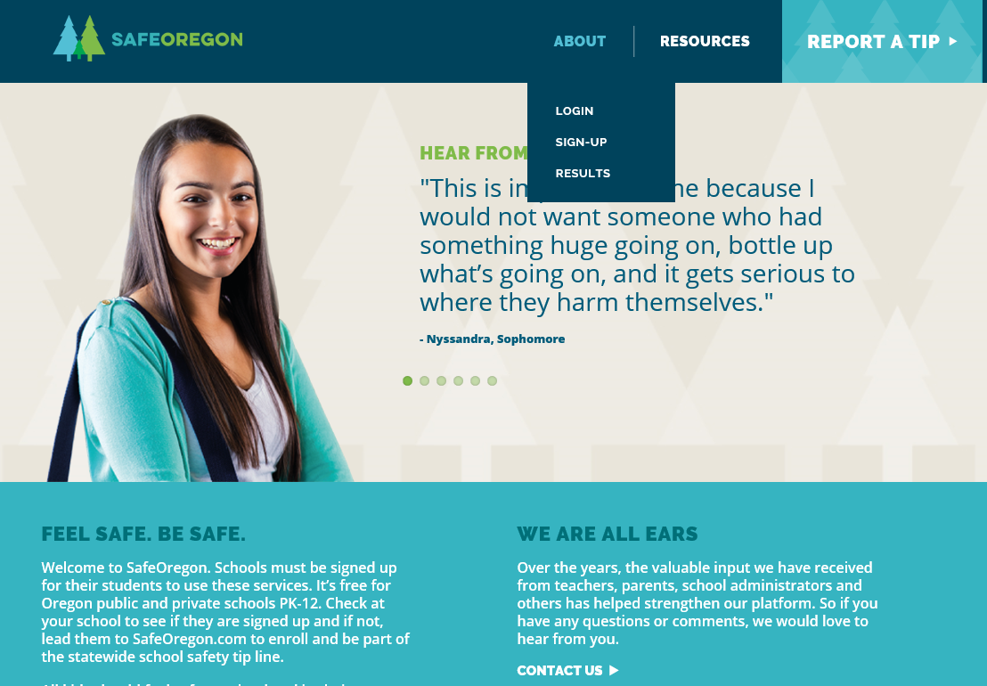
www.safeoregon.com
Back-end process
Record of all tips
Track follow-up on tips
Charts/data
Toolkits
Marketing
Training
Best practice on response to tips
How to launch to your school
Schools designate a Primary Point of Contact and one or more Secondary Points of Contact.
System Follow-up is a click of a box or typed in if it’s important to do so.

Slide 28
Contact OSP
For more information:
Dominique Millette 503-934-0012
dominique.millette@state.or.us

